Slide 1
Traceability Matrix

Slide 2
What Is it?
It is used to track the requirements and to check the current project requirements are met.

Slide 3
What is RTM?
RTM= Requirement Traceability Matrix
Requirement Traceability Matrix (RTM) is a document that maps and traces user requirement with test cases. It captures all requirements proposed by the client and requirement traceability in a single document, delivered at the conclusion of the Software devlopement life cycle.

Slide 4
Why it is Needed
The main purpose of Requirement Traceability Matrix is to validate that all requirements are checked via test cases such that no functionality is unchecked during Software testing.

Slide 5
Its Significance
A question arises on how to make sure that the requirement is tested considering all possible scenarios/cases? How to ensure that any requirement is not left out of the testing cycle?
A simple way is to trace the requirement with its corresponding test scenarios and test cases. This merely is termed as ‘Requirement Traceability Matrix.'

Slide 6
Traceability Matrix
The traceability matrix is typically a worksheet that contains the requirements with its all possible test scenarios and cases and their current state, i.e. if they have been passed or failed. This would help the testing team to understand the level of testing activities done for the specific product.

Slide 7
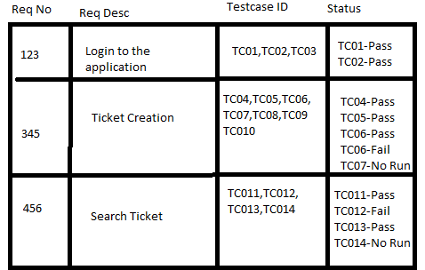
Parameters in RTM
Requirement ID
Requirement Type and Description
Test Cases with Status

Slide 8
Types of Tracebility matrix
Forward traceability: This matrix is used to check whether the project progresses in the desired direction and for the right product. It makes sure that each requirement is applied to the product and that each requirement is tested thoroughly. It maps requirements to test cases.

Slide 9
Types of Tracebility matrix
Backward or reverse traceability: It is used to ensure whether the current product remains on the right track. The purpose behind this type of traceability is to verify that we are not expanding the scope of the project by adding code, design elements, test or other work that is not specified in the requirements. It maps test cases to requirements.

Slide 10
Types of Tracebility matrix
Bi-directional traceability ( Forward+Backward): This traceability matrix ensures that all requirements are covered by test cases. It analyzes the impact of a change in requirements affected by the Defect in a work product and vice versa.

Slide 11

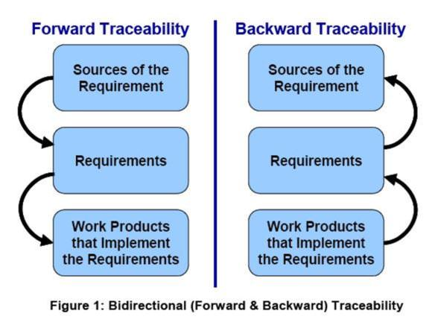

Slide 12
Requirement Management
  Set of activities that help project team to identify, control, and track requirements and changes as project proceeds
  Requirements begin with identification. Each requirement is assigned a unique identifier. Once requirement have been identified, traceability table are developed.
  Traceability Table:
  Features traceability table - shows how requirements relate to customer observable features
  Source traceability table - identifies source of each requirement
  Dependency traceability table - indicate relations among requirements
  Subsystem traceability table - requirements categorized by subsystem
  Interface traceability table - shows requirement relations to internal and external interfaces
  It will help to track, if change in one requirement will affect different aspects of the system.

Slide 13
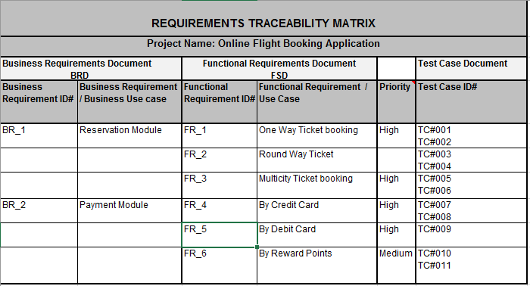

Slide 14
Advantages of Traceability Matrix
it confirms 100% test coverage
It highlights any requirements missing or document inconsistencies
It shows the overall defects or execution status with a focus on business requirements
It helps in analyzing or estimating the impact on the QA team's work with respect to revisiting or re-working on the test cases

Slide 15
Test coverage
Coverage is a measure of how much testing can be done given a set of test cases.
Given a set of test cases, how much of the code in the program being tested is covered?
Or.. Given a set of test cases how many functionalities as listed in the requirements can be tested?
Coverage in most cases is a term associated with white-box testing or structural testing.

Slide 16
Building Test Cases
A TEST CASE is a set of actions executed to verify a particular feature or functionality of your software application. A Test Case contains test steps, test data, precondition, postcondition developed for specific test scenario to verify any requirement. The test case includes specific variables or conditions, using which a testing engineer can compare expected and actual results to determine whether a software product is functioning as per the requirements of the customer.

Slide 17
Test Scenario Vs Test Case
Test scenarios are rather vague and cover a wide range of possibilities. Testing is all about being very specific.
For a Test Scenario: Check Login Functionality there many possible test cases are:
Test Case 1: Check results on entering valid User Id & Password
Test Case 2: Check results on entering Invalid User ID & Password
Test Case 3: Check response when a User ID is Empty & Login Button is pressed, and many more

Slide 18
Building Test Cases
Step 1) A simple test case to explain the scenario would be
Test Case # Test Case Description
1 Check response when valid email and
        password is entered
Step 2) In order to execute the test case, you would need Test Data. Adding it below

Slide 19
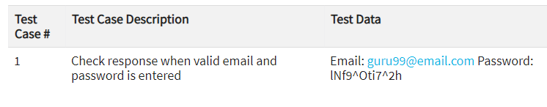
Building Test Cases
Identifying test data can be time-consuming and may sometimes require creating test data afresh. The reason it needs to be documented.

Slide 20
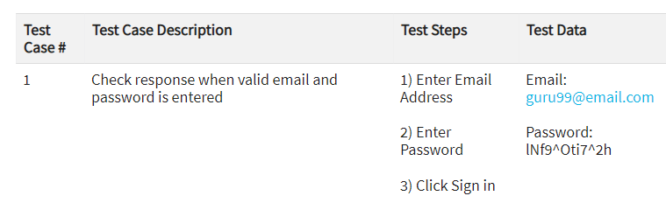
Building Test Cases
Step 3) In order to execute a test case, a tester needs to perform a specific set of actions . This is documented as below:

Slide 21
Building Test Cases
Many times the Test Steps are not simple as above, hence they need documentation.
Also, the author of the test case may leave the organization or go on a vacation or is sick and off duty or is very busy with other critical tasks.
A recently hire may be asked to execute the test case. Documented steps will help him and also facilitate reviews by other stakeholders.

Slide 22
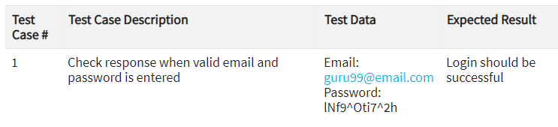
Building Test Cases
Step 4) The goal of test cases in software testing is to check behavior of the AUT for an expected result. This needs to be documented as below
During test execution time, the tester will check expected results against actual results and assign a pass or fail status

Slide 23
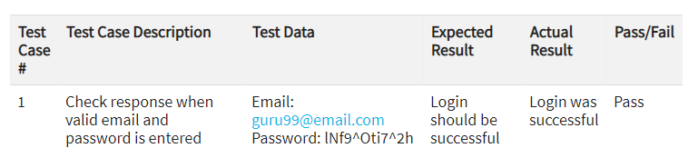
Building Test Cases

Slide 24
Building Test Cases
Step 5) That apart your test case -may have a field like, Pre - Condition which specifies things that must in place before the test can run. For our test case, a pre-condition would be to have a browser installed to have access to the site under test. A test case may also include Post - Conditions which specifies anything that applies after the test case completes. For our test case, a postcondition would be time & date of login is stored in the database

Slide 25
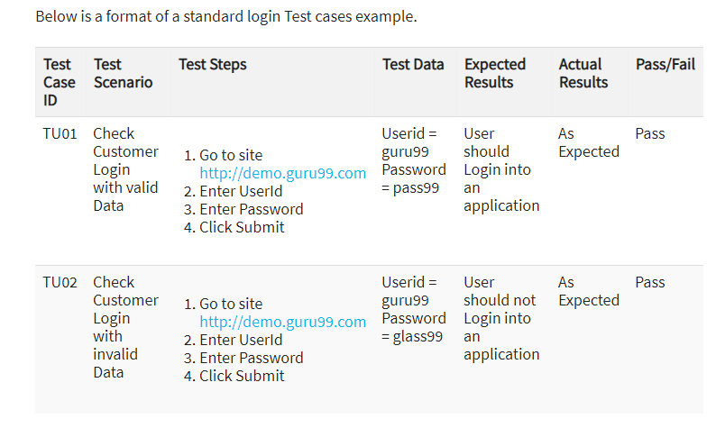

Slide 26
Building Test Cases
Best Practice for writing good Test Case Example.
1. Test Cases need to be simple and transparent:
Create test cases that are as simple as possible. They must be clear and concise as the author of the test case may not execute them.
Use assertive language like go to the home page, enter data, click on this and so on. This makes the understanding the test steps easy and tests execution faster.
2. Create Test Case with End User in Mind
The ultimate goal of any software project is to create test cases that meet customer requirements and is easy to use and operate. A tester must create test cases keeping in mind the end user perspective
3. Avoid test case repetition.
Do not repeat test cases. If a test case is needed for executing some other test case, call the test case by its test case id in the pre-condition column

Slide 27
Building Test Cases
Best Practice for writing good Test Case Example.
4. Do not Assume
Do not assume functionality and features of your software application while preparing test case. Stick to the Specification Documents.
5. Ensure 100% Coverage
Make sure you write test cases to check all software requirements mentioned in the specification document. Use Traceability Matrix to ensure no functions/conditions is left untested.
6. Test Cases must be identifiable.
Name the test case id such that they are identified easily while tracking defects or identifying a software requirement at a later stage.

Slide 28
Building Test Cases
Best Practice for writing good Test Case Example.
7. Implement Testing Techniques
It's not possible to check every possible condition in your software application. Software Testing techniques help you select a few test cases with the maximum possibility of finding a defect.
Boundary Value Analysis (BVA): As the name suggests it's the technique that defines the testing of boundaries for a specified range of values.
Equivalence Partition (EP): This technique partitions the range into equal parts/groups that tend to have the same behavior.
State Transition Technique: This method is used when software behavior changes from one state to another following particular action.
Error Guessing Technique: This is guessing/anticipating the error that may arise while doing manual testing. This is not a formal method and takes advantages of a tester's experience with the application

Slide 29
Building Test Cases
Best Practice for writing good Test Case Example.
8. Self-cleaning
The test case you create must return the Test Environment to the pre-test state and should not render the test environment unusable. This is especially true for configuration testing.
9. Repeatable and self-standing
The test case should generate the same results every time no matter who tests it
10. Peer Review.
After creating test cases, get them reviewed by your colleagues. Your peers can uncover defects in your test case design, which you may easily miss.

Slide 30
Defect Management
Defect Management is a systematic process to identify and fix bugs.
A defect management cycle contains the following stages
1) Discovery of Defect,
2) Defect Categorization
3) Fixing of Defect by developers
4) Verification by Testers,
5) Defect Closure
6) Defect Reports at the end of project
02/11/20

Slide 31
Bug Report in Software Testing
A Bug Report in Software Testing is a detailed document about bugs found in the software application. Bug report contains each detail about bugs like description, date when bug was found, name of tester who found it, name of developer who fixed it, etc. Bug report helps to identify similar bugs in future so it can be avoided.
While reporting the bug to developer, your Bug Report should contain the following information
Defect_ID - Unique identification number for the defect.
Defect Description - Detailed description of the Defect including information about the module in which Defect was found.
Version - Version of the application in which defect was found.
Steps - Detailed steps along with screenshots with which the developer can reproduce the defects.

Slide 32
Bug Report in Software Testing
Date Raised - Date when the defect is raised
Reference- where in you Provide reference to the documents like . requirements, design, architecture or maybe even screenshots of the error to help understand the defect
Detected By - Name/ID of the tester who raised the defect
Status - Status of the defect like Assigned/Fixed/rejected
Fixed by - Name/ID of the developer who fixed it
Date Closed - Date when the defect is closed
Severity which describes the impact of the defect on the application
Priority which is related to defect fixing urgency. Severity Priority could be High/Medium/Low based on the impact urgency at which the defect should be fixed respectively

Slide 33
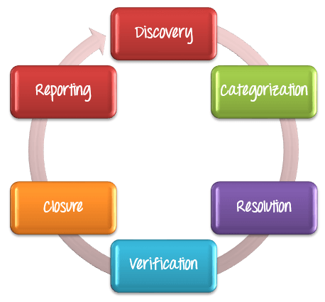
Process
02/11/20

Slide 34
Discovery
In the discovery phase, the project teams have to discover as many defects as possible, before the end customer can discover it. A defect is said to be discovered and change to status accepted when it is acknowledged and accepted by the developers
02/11/20

Slide 35
Categorization
Defect categorization help the software developers to prioritize their tasks. That means that this kind of priority helps the developers in fixing those defects first that are highly crucial.
02/11/20

Slide 36
Defect Resolution
Defect Resolution in software testing is a step by step process of fixing the defects. Defect resolution process starts with assigning defects to developers, then developers schedule the defect to be fixed as per priority, then defects are fixed and finally developers send a report of resolution to the test manager. This process helps to fix and track defects easily.
02/11/20

Slide 37
Resolution Steps
Assignment: Assigned to a developer or other technician to fix, and changed the status to Assigned/Responding.
Schedule fixing: The developer side take charge in this phase. They will create a schedule to fix these defects, depend on the defect priority.
Fix the defect: While the development team is fixing the defects, the Test Manager tracks the process of fixing defect compare to the above schedule.
Report the resolution: Get a report of the resolution from developers when defects are fixed.
02/11/20

Slide 38
Verification
After the development team fixed and reported the defect, the testing team verifies that the defects are actually resolved.
02/11/20

Slide 39
Closure
Once a defect has been resolved and verified, the defect is changed status as closed. If not, you have send a notice to the development to check the defect again.
02/11/20

Slide 40
Defect Reporting
Defect Reporting in software testing is a process in which test managers prepare and send the defect report to the management team for feedback on defect management process and defects’ status. Then the management team checks the defect report and sends feedback or provides further support if needed. Defect reporting helps to better communicate, track and explain defects in detail.
02/11/20

Slide 41
Bug Report in Software Testing
A Bug Report in Software Testing is a detailed document about bugs found in the software application. Bug report contains each detail about bugs like description, date when bug was found, name of tester who found it, name of developer who fixed it, etc. Bug report helps to identify similar bugs in future so it can be avoided.
While reporting the bug to developer, your Bug Report should contain the following information
Defect_ID - Unique identification number for the defect.
Defect Description - Detailed description of the Defect including information about the module in which Defect was found.
Version - Version of the application in which defect was found.
Steps - Detailed steps along with screenshots with which the developer can reproduce the defects.

Slide 42
Bug Report in Software Testing
Date Raised - Date when the defect is raised
Reference- where in you Provide reference to the documents like . requirements, design, architecture or maybe even screenshots of the error to help understand the defect
Detected By - Name/ID of the tester who raised the defect
Status - Status of the defect like Assigned/Fixed/rejected
Fixed by - Name/ID of the developer who fixed it
Date Closed - Date when the defect is closed
Severity which describes the impact of the defect on the application
Priority which is related to defect fixing urgency. Severity Priority could be High/Medium/Low based on the impact urgency at which the defect should be fixed respectively

